Slide 1
International Standards and Legal Framework of Information Security
Lecture 3

Slide 2
Covered in Lecture
Information Security Legal Framework
Background and context
Information Security Management Systems (ISMS)
Information Security Policy
Asset and Risk Assessment

Slide 3
Specific regulations and cybersecurity frameworks
NIST (National Institute of Standards and Technology)
CIS Controls (Center for Internet Security Controls)
ISO (International Organization for Standardization)
HIPAA (Health Insurance Portability and Accountability Act) / HITECH Omnibus Rule
PCI-DSS (The Payment Card Industry Data Security Standard)
GDPR (General Data Protection Regulation)
CCPA (California Consumer Privacy Act)
AICPA (American Institute of Certified Public Accountants)

Slide 4
Specific regulations and cybersecurity frameworks
SOX (Sarbanes-Oxley Act)
COBIT (Control Objectives for Information and Related Technologies)
GLBA (Gramm-Leach-Bliley Act)
FISMA (Federal Information Security Modernization Act of 2014)
FedRAMP (The Federal Risk and Authorization Management Program)
FERPA (The Family Educational Rights and Privacy Act of 1974)
ITAR (International Traffic in Arms Regulations)
COPPA (Children’s Online Privacy Protection Rule)
NERC CIP Standards (NERC Critical Infrastructure Protection Standards)

Slide 5
Compliance Regulations
Regulations are in place to help companies improve their information security strategy by providing guidelines and best practices based on the company’s industry and type of data they maintain.
Non-compliance with these regulations can result in severe fines, or worse, a data breach.
Most companies are subject to at least one security regulation. The difficulty comes in determining which ones apply and interpreting what policies and controls are required to reach compliance.

Slide 6
NIST (National Institute of Standards and Technology)
This framework was created to provide a customizable guide on how to manage and reduce cybersecurity related risk by combining existing standards, guidelines, and best practices.
It also helps foster communication between internal and external stakeholders by creating a common risk language between different industries.

Slide 7
CIS Controls (Center for Internet Security Controls)
PCI-DSS (Payment Card Industry Data Security Standard)
Protect your organization assets and data from known cyber attack vectors.
A set of 12 regulations designed to reduce fraud and protect customer credit card information.

Slide 8
GDPR (General Data Protection Act)
COBIT (Control Objectives for Information and Related Technologies)
This regulates the data protection and privacy of citizens of the European Union.
This framework was developed to help organizations manage information and technology governance by linking business and IT goals.

Slide 9
ISO 27000 Family (International Organization for Standardization)
This family of standards provide security requirements around the maintenance of information security management systems (ISMS) through the implementation of security controls.

Slide 10
All state agencies and organisations shall have a management system for information security
The management system should be based on recognized security standards
The system's scope and level of detail has to be adapted to the risk “appetite”, scope and nature of the individual organizations

Slide 11
The institutions shall:
have contingency plans that should be based on regular risk and vulnerability assessments and perform annual emergency drills
comply with applicable regulations and guidelines for information security, including having or introducing an information security management system built on the principles of recognized security standards
continue to work with the follow-up recommendations to strengthen risk awareness, security culture, attitudes and leadership

Slide 12
Where are management systems used?
Corporate Governance - COSO ERM framework
Financial - Economy Regulations
Quality Control - ISO 9000 series
IT management – COBIT, TOGAF, ITIL, ISO 38500
HSE – OHSAS 18001
Environmental Management - ISO 14001
Food security - ISO 22000
Information security - ISO 27000 series, COBIT 5 for IS, NIST, ISF Best Practice

Slide 13
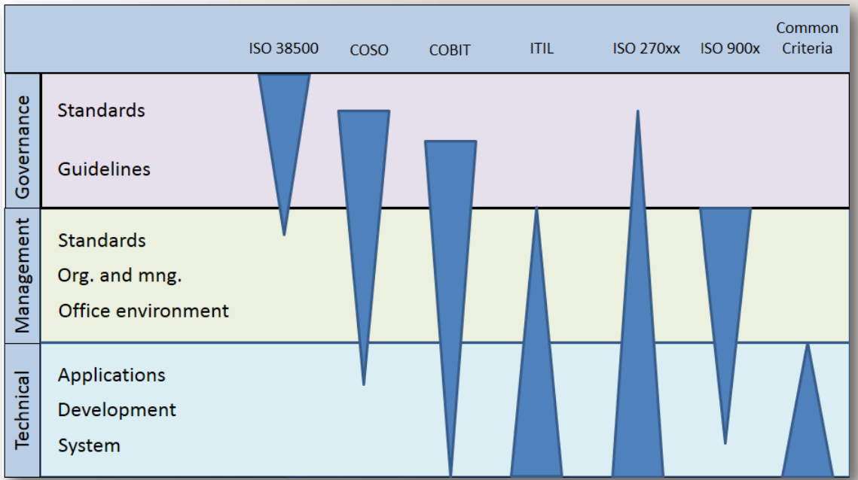
Frameworks and standards
Source: Jan T. Bjørnsen 2012

Slide 14
General requirements for ISMS on the organization
develop
implement
maintain
continually improve documented ISMS

Slide 15
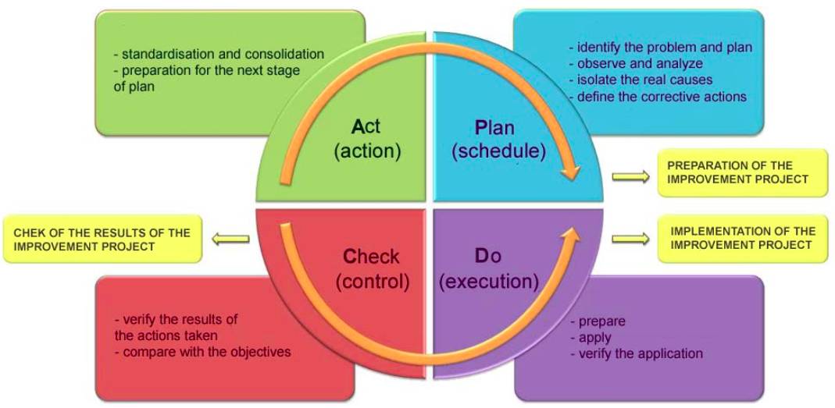
PDCA model (Work Life Management)

Slide 16
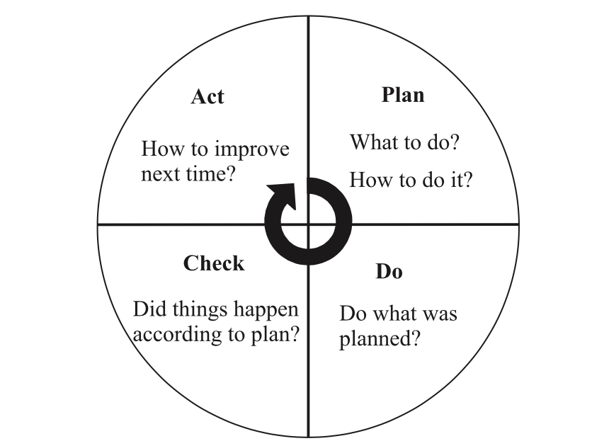
The PDCA model applied to ISMS process

Slide 17
PDCA model
Plan
Do
Check
Act

Slide 18
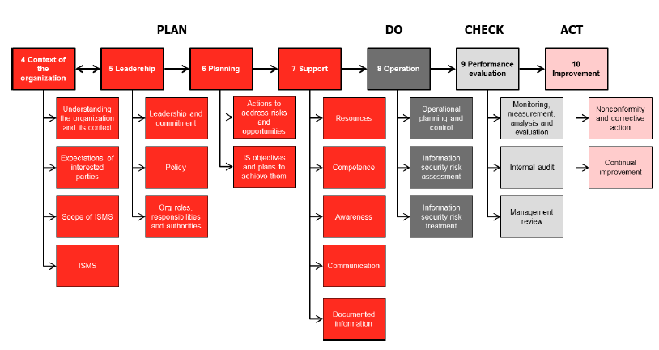
ISO 27001 STRUCTURE

Slide 19
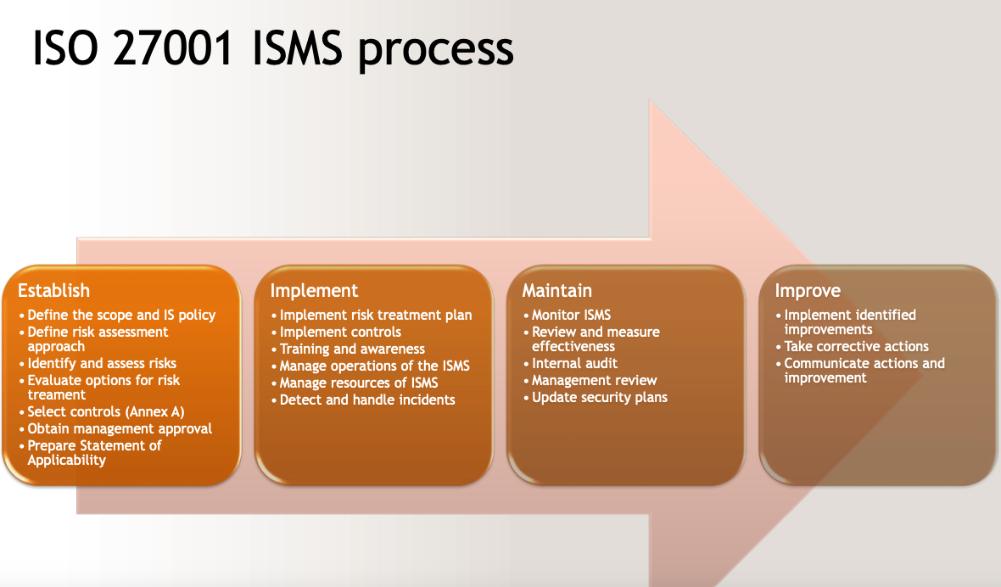

Slide 21
Establish
Define the scope and IS policy
Define risk assessment approach
Identify and assess risks
Evaluate options for risk treament
Select controls (Annex A)
Obtain management approval
Prepare Statement of Applicability

Slide 22
Implement
Implement risk treatment plan
Implement controls
Training and awareness
Manage operations of the ISMS
Manage resources of ISMS
Detect and handle incidents

Slide 23
Maintain
Monitor ISMS
Review and measure effectiveness
Internal audit
Management review
Update security plans

Slide 24
Improve
Implement identified improvements
Take corrective actions
Communicate actions and improvement

Slide 25
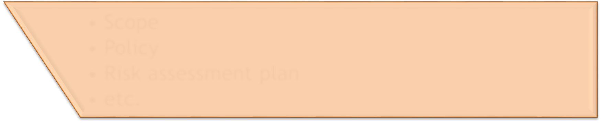
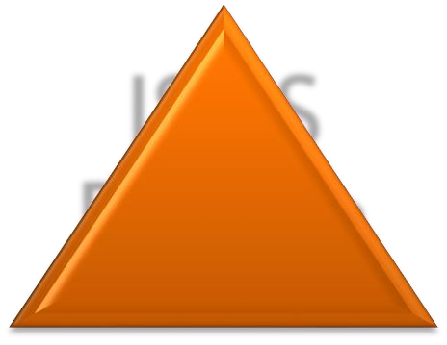

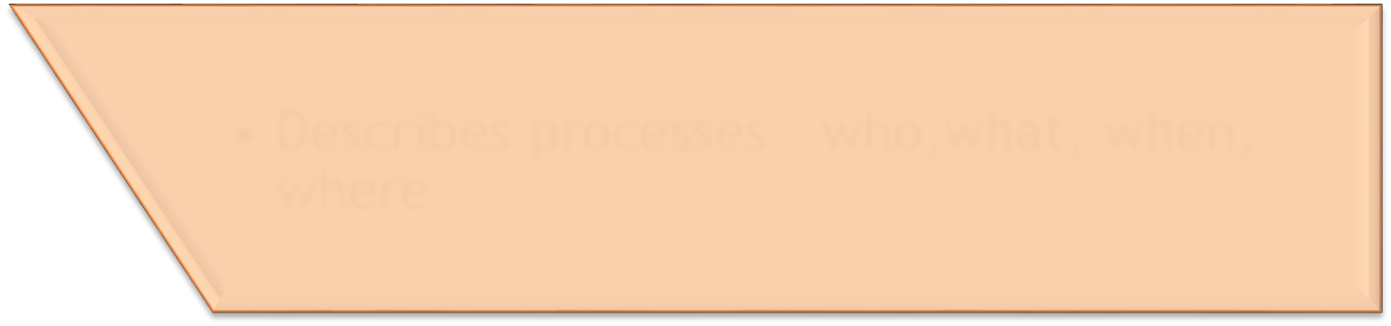



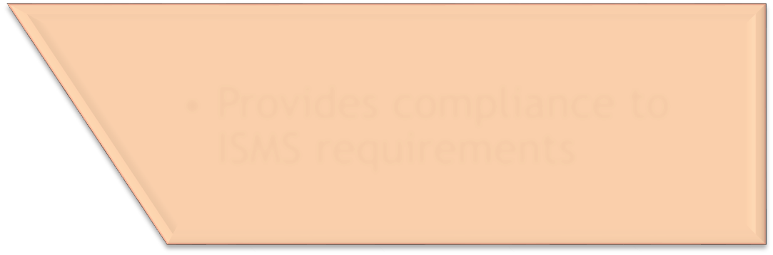
ISMS Document Hieracy
ISMS
Design
Scope
Policy
Risk assessment plan
etc.
Procedures Principles
Describes processes – who,what, when,
where
Work instructions
Describes how tasks and spesific activities are executed
Documents and records
Provides compliance to ISMS requirements

Slide 26

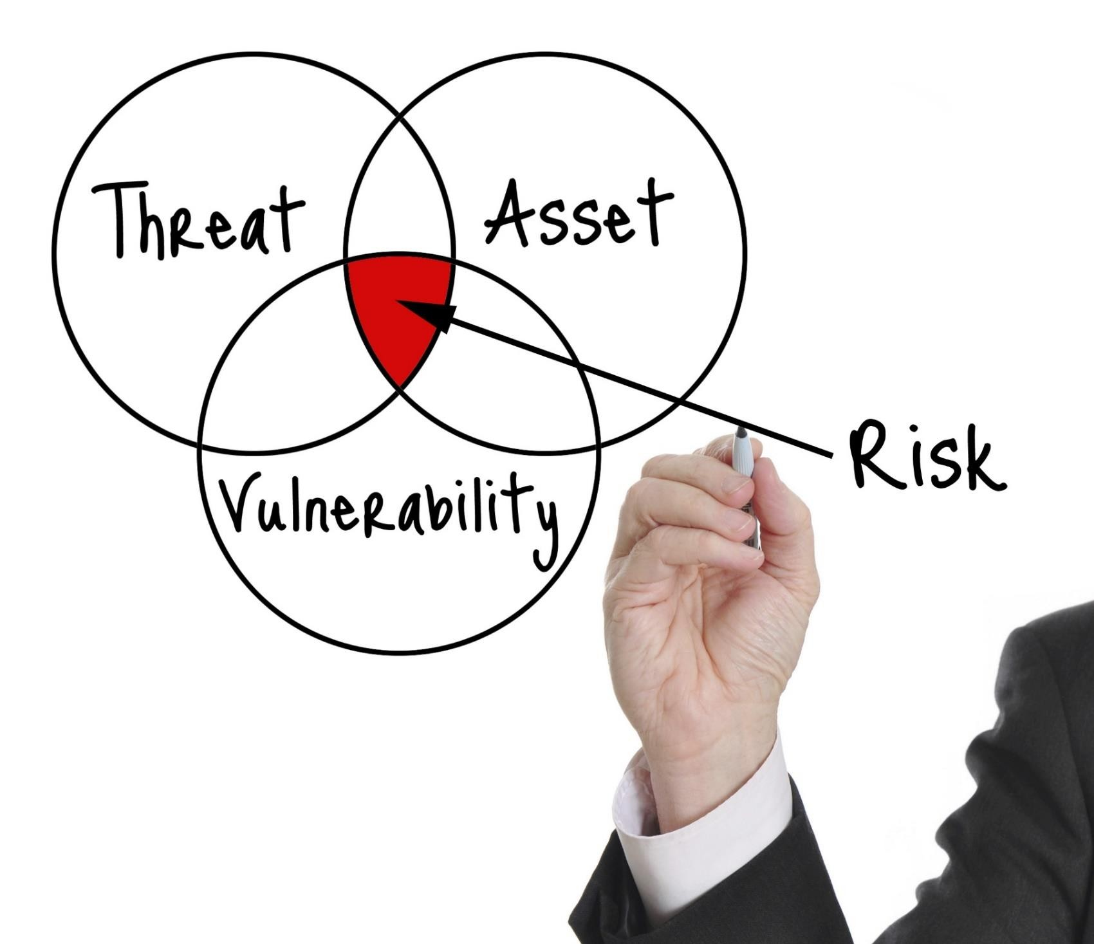
Risk treatment is the essential activity

Slide 27
Base of risk analysis is fulfilment of following activities:
– threats identification;
– estimation of threat likelihood;
– identification of assets (process);
– rating of assets (process);
– determination of vulnerabilities;
– calculation of expected losses at threat impact;
– evaluation of risk analysis.

Slide 28
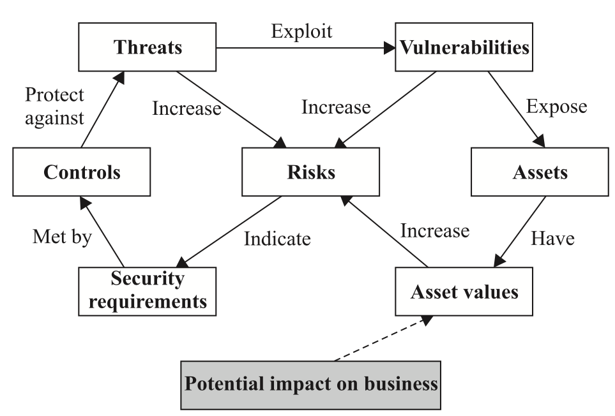
interrelationships in risk management

Slide 29
The structure of controls (Ref. ISO 27002)
Information security policies
Organization of information security
Personal security
Asset management
Access control
Cryptography
Physical and environmental security
Operations security
Communication security
System acquisition, development and maintenance
Supplier relationships
Incident handling
Business continuity
Compliance
Describe the controls in the statement of applicability (SOA). Also explain why controls are omitted

Slide 30




The main elements of a IS management system based on ISO 27001
Policy (focus, goals and guidelines)
Define acceptable risk
Systematic and periodic risk assessments
Action plan for implementing selected security controls
Events and exception handling Systematic internal audits
Management reviews on planned intervals
Improve
Establish
Maintain
Implement
Around these elements are requirements for management commitment, resources, document content, taxonomy, monitoring results and continuous improvement.

Slide 31
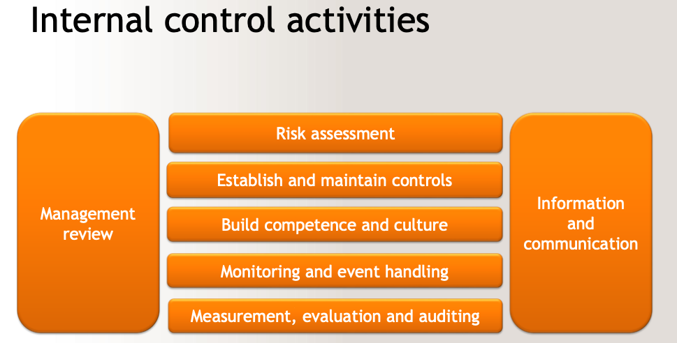

Slide 32
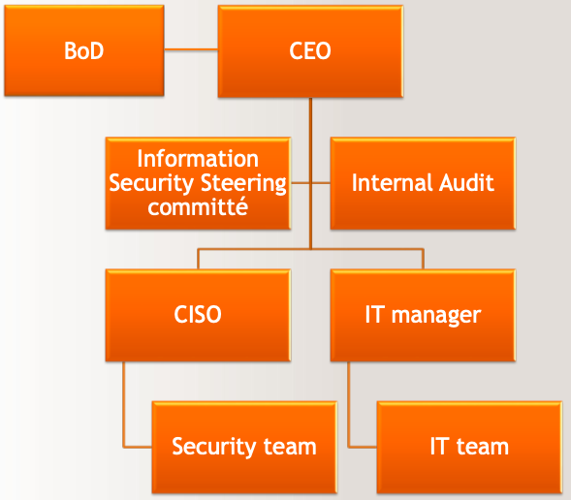
Information Security Functions

Slide 33
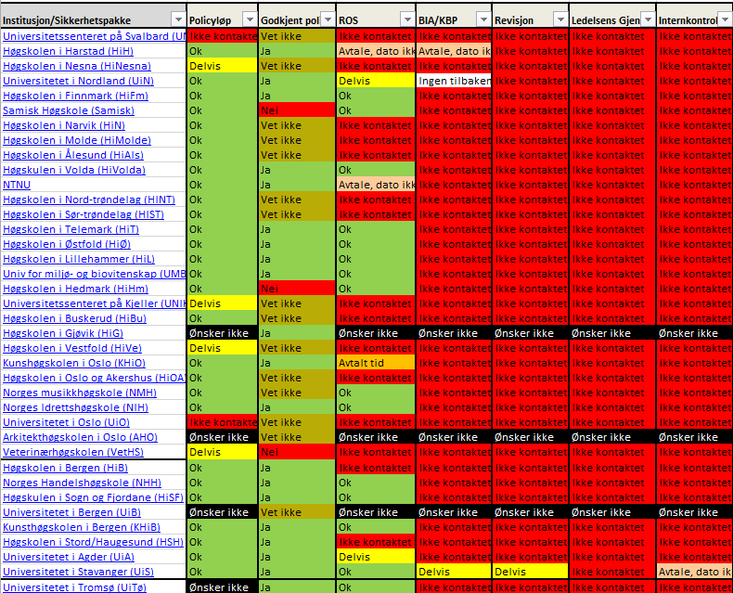
Monitoring - example
Policy
Risk assessment
Business impact assessment
Information security continuity plan
Audit
Management review
Information security management system!

Slide 34
ISO 27001 about IS Policy
Top management shall establish an information security policy that:
is appropriate to the purpose of the organization
includes information security objectives or provides the framework for setting information security objectives
includes a commitment to satisfy applicable requirements related to information security
includes a commitment to continual improvement of the information security management system
The information security policy shall:
be available as documented information
be communicated within the organization
be available to interested parties, as appropriate

Slide 35
Basic requirements for an IS Policy
An information security policy must
be possible to implement and enforce
be concise and easy to understand
balance protection with productivity
express why it is established
describe what it covers
define the responsibilities and contact points
specify how the deviations will be handled

Slide 36
Content of Information Security Policy
Information security policy with goals and strategy
Roles and responsibilities
Principles for information security
Structure of governing documents

Slide 37
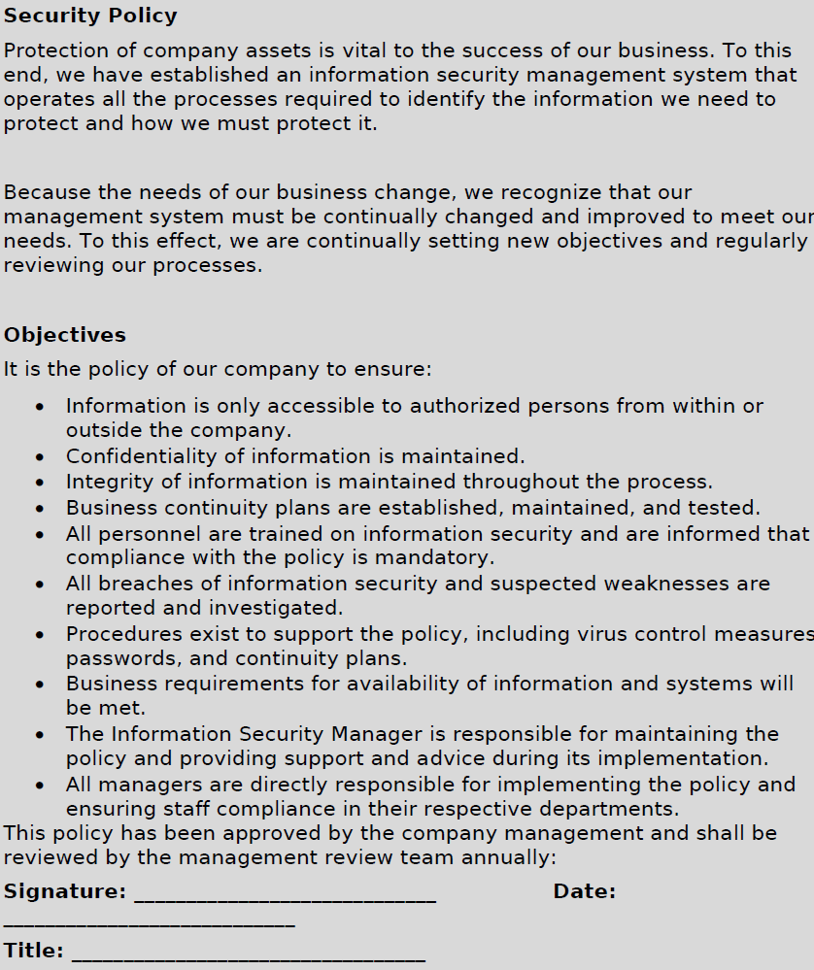

Slide 38
Security goals
<University> is committed to safeguard the confidentiality, integrity and availability of all physical and electronic information assets of the institution to ensure that regulatory, operational and contractual requirements are fulfilled.
The overall goals for information security at <University> are the following:
Ensure compliance with current laws, regulations and guidelines.
Comply with requirements for confidentiality, integrity and availability for
<University>'s employees, students and other users.
Establish controls for protecting <University>'s information and information systems against theft, abuse and other forms of harm and loss.
Motivate administrators and employees to maintain the responsibility for, ownership of and knowledge about information security, in order to minimize the risk of security incidents.

Slide 39
Security goals (cont.)
Ensure that <University> is capable of continuing their services even if major security incidents occur.
Ensure the protection of personal data (privacy).
Ensure the availability and reliability of the network infrastructure and the services supplied and operated by <University>.
Comply with methods from international standards for information security,
e.g. ISO/IEC 27001.
Ensure that external service providers comply with <University>'s information security needs and requirements.
Ensure flexibility and an acceptable level of security for accessing information systems from “offcampus”.

Slide 40
Security strategy
<University>'s current business strategy and framework for risk management are the guidelines for identifying, assessing, evaluating and controlling information related risks through establishing and maintaining the information security policy (this document).
It has been decided that information security is to be ensured by the policy for information security and a set of underlying and supplemental documents. In order to secure operations at <X University> even after serious incidents, <University> shall ensure the availability of continuity plans, backup procedures, defense against damaging code and malicious activities, system and information access control, incident management and reporting.

Slide 41
Security strategy (cont.)
The term information security is related to the following basic concepts:
Confidentiality:
The property that information is not made available or disclosed to unauthorized individuals, entities, or processes.
Integrity:
The property of safeguarding the accuracy and completeness of assets.
Availability:
The property of being accessible and usable upon demand by an authorized entity.

Slide 42
Security strategy (cont.)
Some of the most critical aspects supporting <X University>'s activities are availability and reliability for network, infrastructure and services. <X University> practices openness and principles of public disclosure, but will in certain situations prioritize confidentiality over availability and integrity.
Every user of <X University>'s information systems shall comply with this information security policy. Violation of this policy and of relevant security requirements will therefore constitute a breach of trust between the user and <X University>, and may have consequences for employment or contractual relationships.
……………………………. Chancellor/President of <University>

Slide 43
Principles for information security
Risk management Security organization
Classification and control of assets
Information security in connection with users of the institutions services
Information security regarding physical conditions
IT communications and operations management
Access control
Information systems acquisition, development and maintenance
Information security incident management
Continuity planning
Compliance

Slide 44
Example of principles
Risk management
3.1.1 Risk assessment and management
<University>'s approach to security should be based on risk assessments.
<University> should continuously assess the risk and evaluate the need for protective measures. Measures must be evaluated based on
<University>'s role as an establishment for education and research and with regards to efficiency, cost and practical feasibility.
An overall risk assessment of the information systems should be performed annually.

Slide 45
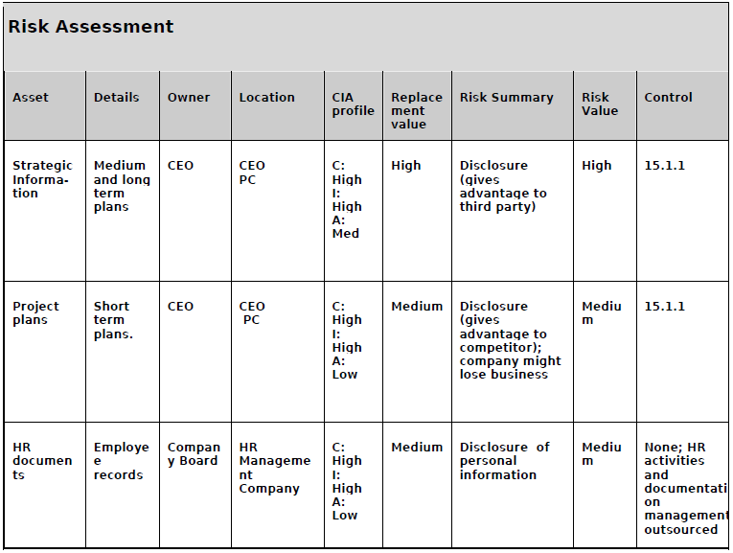

Slide 46
How to implement the Information Security Policy?
Preparations
Start-up meeting with executive/top management (Important!)
One-day on-site audit / review Interviews with key personnel
Review of the received documentation\
COBIT 4.1 Assurance Guide or ISO
27003 Annex C Information about internal auditing, can be used as a guideline for the audit

Slide 47
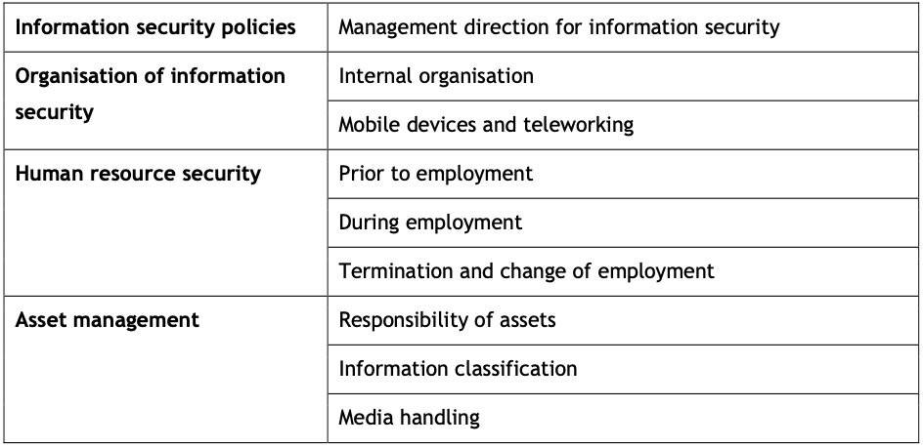
Structure of information security management systems

Slide 48
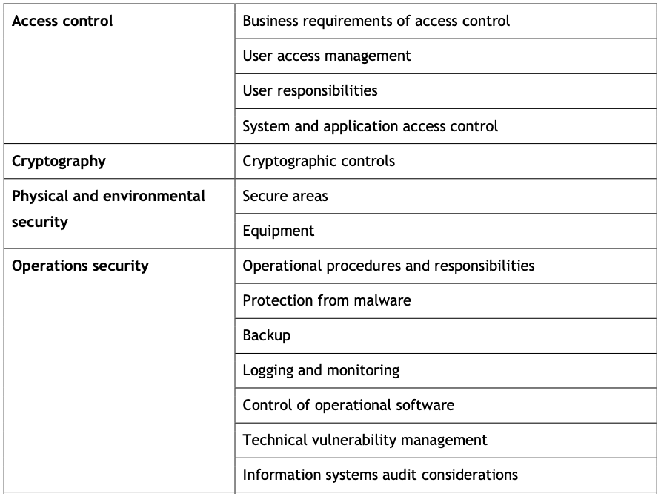

Slide 49
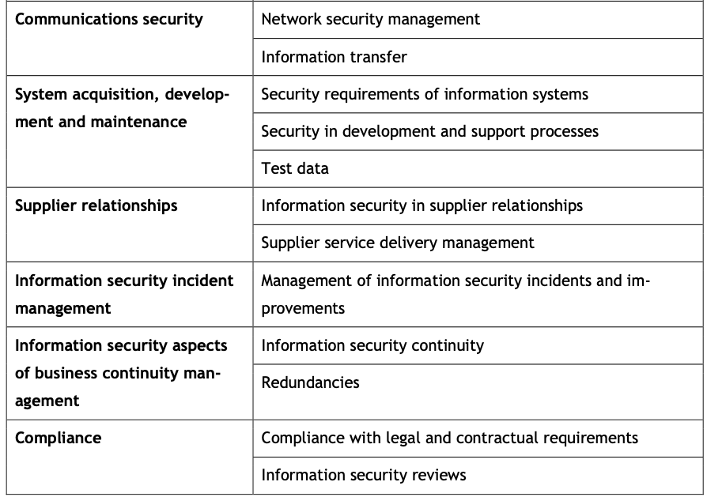

Slide 50
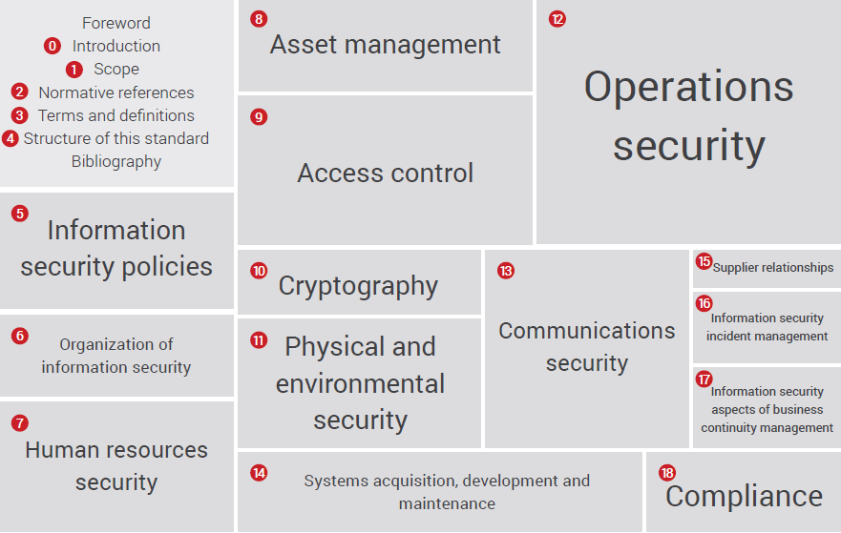

Slide 51
Roadmap for implementing the IS policy
Perform an initial audit or an assessment of the organisation
Draft the policy before workshop
Arrange the policy workshop
Internal adaptation by the management
Review by other stakeholders
Approval by the Board
Implement the policy; publishing, information, training
Revision process after 6-12 months

Slide 52
Overall recommendations for ISMS
Establish Security Policy which adhere to ISO 27002 or COBIT, and implement
it, including a selection of procedures
Establish the role of Chief Information Security Officer (CISO) and formally anchor the responsibility for information security in senior management
Identify business critical assets (Information, Servers, Resources etc.)
Perform risk assessments on business critical assets with respect to confidentiality, integrity and availability
Establish a security architecture based on the concept of security levels
Develop Information Security Continuity Plan and ICT Disaster Recovery
Plan

Slide 53
Guidelines for Classification of information
Recommendation on how to classify information
Examples of how information objects that are frequently used in the higher education sector can be classified
References to relevant standards, laws and regulations

Slide 54
The assets are grouped under the following categories:
Information assets
Software assets
Physical Assets
Services

Slide 55
Following information should be compiled for the organization:
List of information systems included in the ISMS List of assets and their owners
Replacement value of these assets
Location of the assets
Classification of these assets

Slide 56
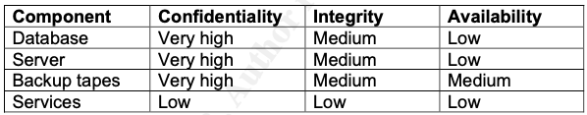
Example: Human Resources System
Confidentiality : Very high, the employee data should be maintained at highest confidentiality level.
Integrity : Medium, the data is verified at various stages and any changes to it would be detected.
Availability: Low, the system is not required on-line. A delay of up to one day in getting requisite information is acceptable.

Slide 57
Identify and Assess the Risks
threat analysis
vulnerability analysis
asset risk evaluation

Slide 58
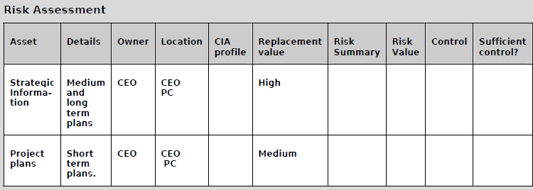

Slide 59
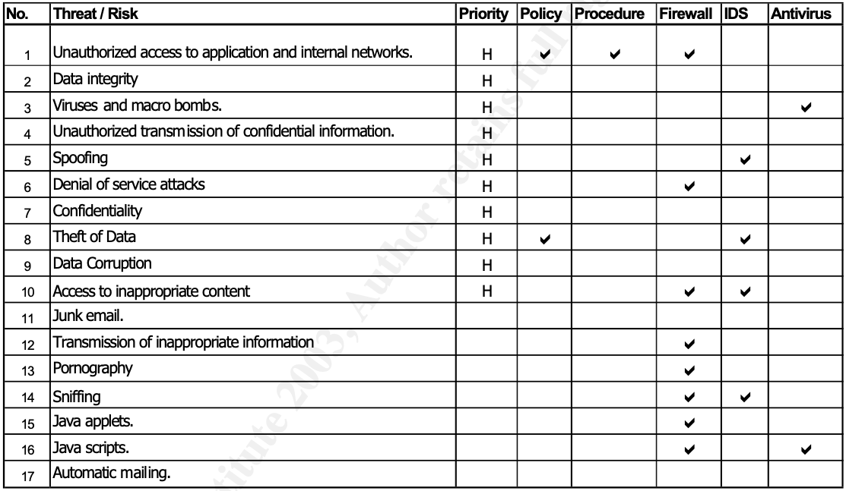

Slide 60
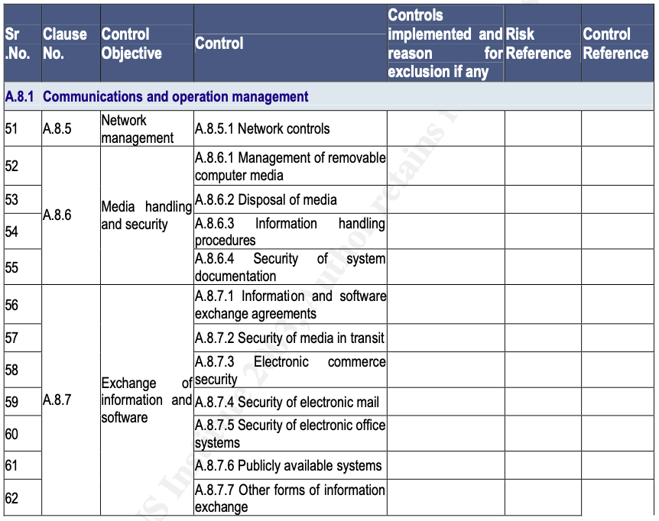

Slide 61
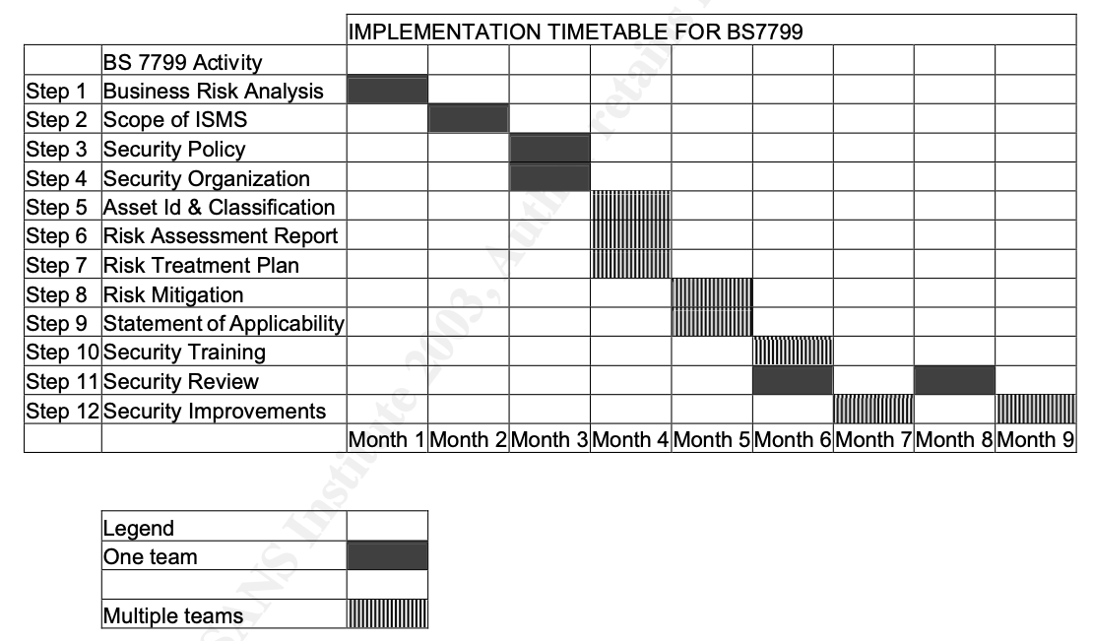

Slide 62
References:
Information Security Management System: https://isoconsultantkuwait.com/2019/07/20/2392/
Avinash Kadam, Implementation Methodology for Information Security Management System, SANS Institute
Information technology — Security techniques — Information security management systems — Overview and vocabulary : ISO/IEC 27000
Information technology. Security techniques. Information security risk management: BS ISO/IEC 27005
https://www.iso27001security.com/ISO27k_Standards_listing.pdf

